Slide 1
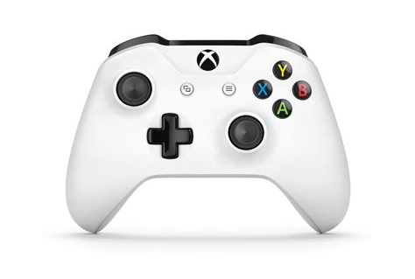
Joystick 0 Controls
Left Bumper: Traction
Right Bumper: Butterfly
Hold Left Trigger: Release HATCH/CARGO
Left Trigger Climbing Mode: Declimb (robot down)
Right Trigger: Toggles CARGO Intake
Right Trigger Climbing Mode: Climb (robot up)
Drive Base Foward/backward
Hold button: Goes to traction, exits
to previous state
Press button: Brake
Autopilot
Low Gear
Master Cancel
1. Autostow
2. Clears errors: tilt interlock /
encoder failure/ motor failure/ limit
Switch check
3. Toggles drive
bias in climb
High Gear
Signal Human Player
Turn Drive Base
Button: Super Turn
Manual Elevator
(not in climb)
Climb Confirmation
1. On the HAB
2. Retract PTOs
Left Rumbles:
1. Target lock
2. Change in elevator state
Right Rumbles:
1. Have a HATCH/CARGO
2. On the HAB
Written by Amelia and Amelie

Slide 2
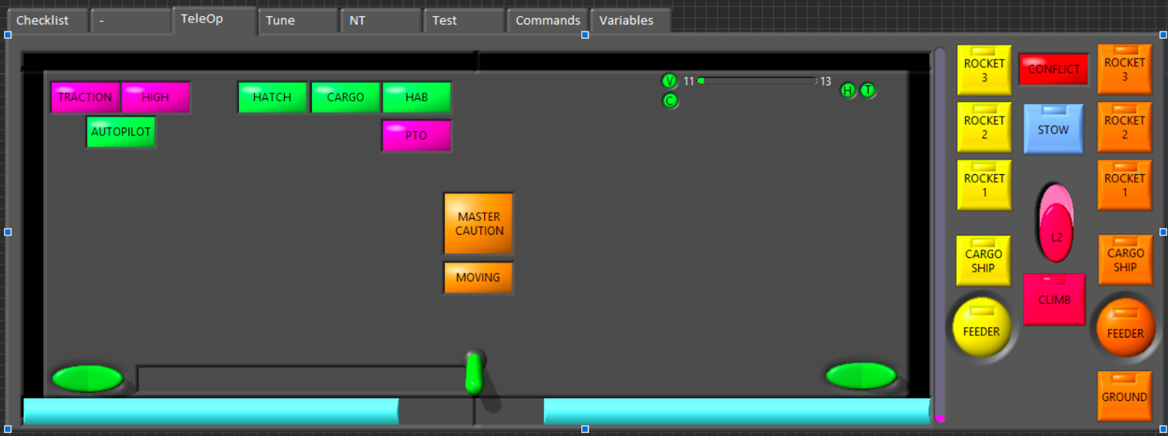

Slide 3
